Slide 1
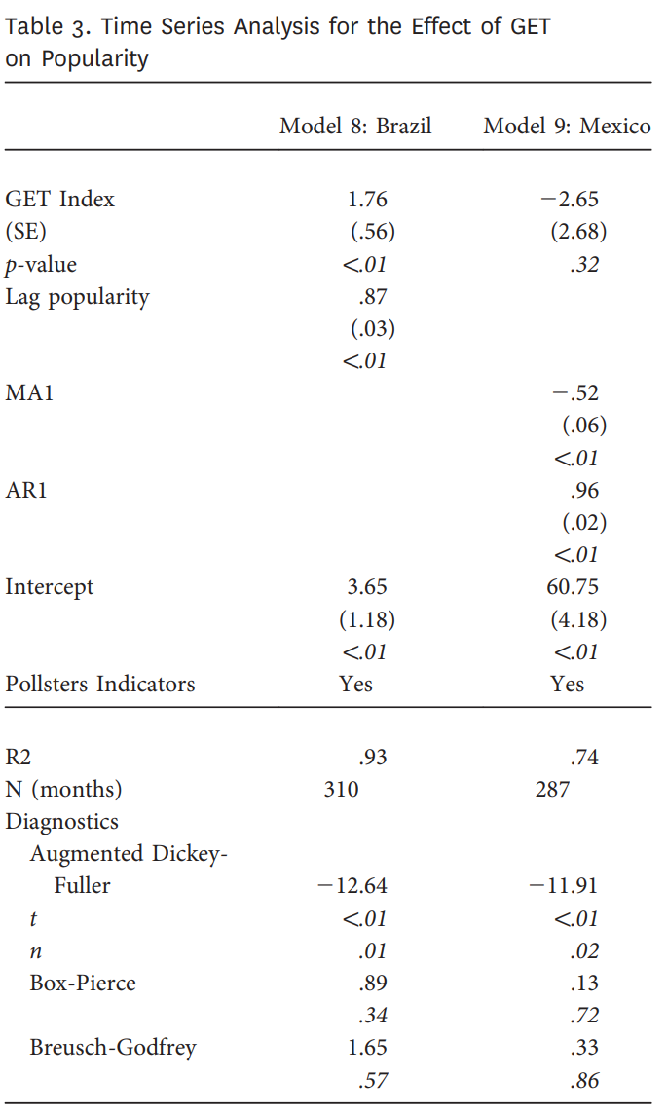
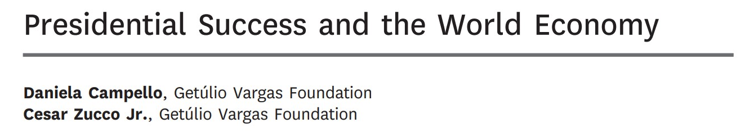
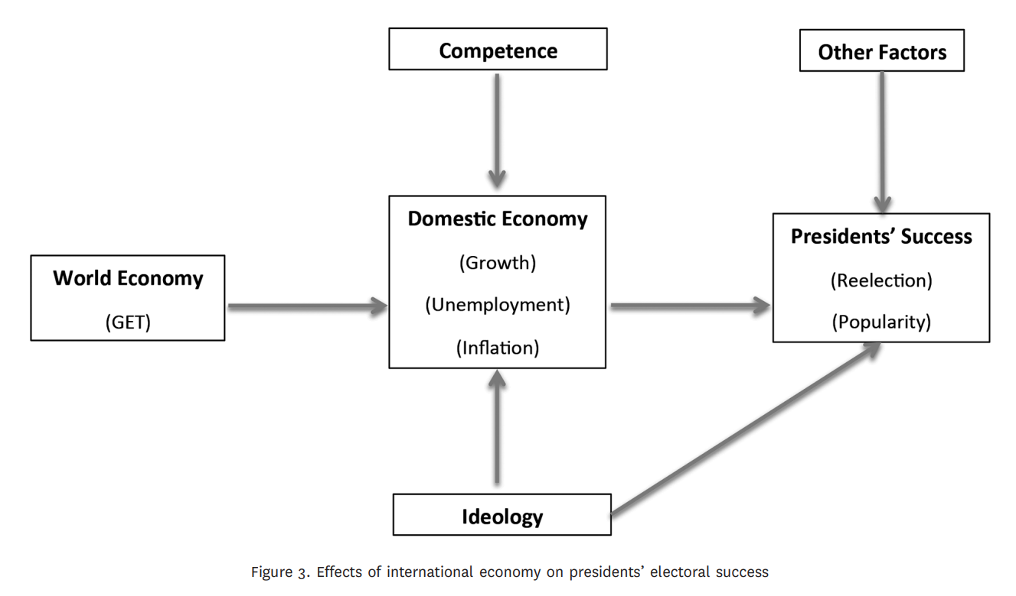
How conditions of the World Economy affect presidential success in LSCE?
Brazil and Mexico Comparison: Brazil, as a commodity-exporting country highly dependent on international capital flows, is expected to be influenced by the GET index. In contrast, Mexico, with ties to the U.S. consumer market, may not be significantly affected.
OLS Model: A simple OLS model, including only the monthly GET index as an independent variable. Results show a strong covariation between GET and popularity in Brazil (R2 = 0.63) but weak covariation in Mexico (R2 = 0.12).

Slide 2
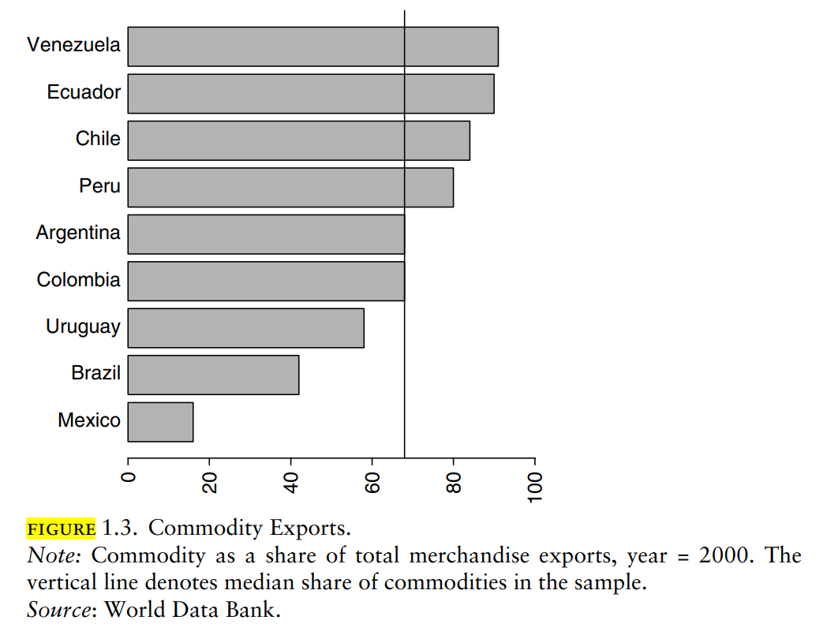
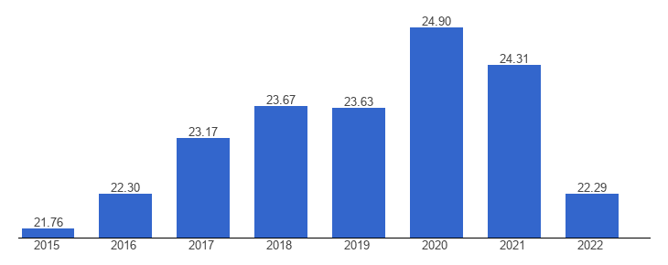
How conditions of the US economy affect presidential success in Mexico?
How conditions of the US economy affect Mexican Economy?
Interest Rates: yes
Commodity exports: not as much*
Low Savings? 21-24%
Mexico: Savings, percent of GDP - Recent values
The average for 2022 based on 85 countries was 23.91 percent.

Slide 3
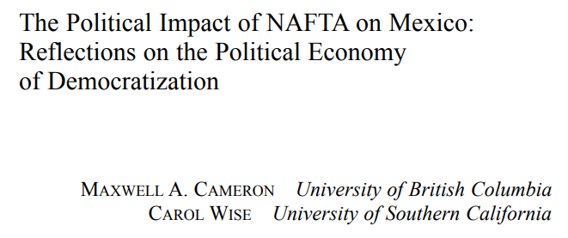
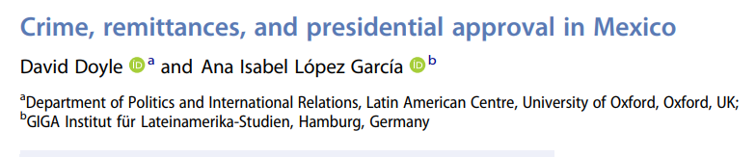
How conditions of the US economy affect presidential success in Mexico?
How conditions of the US economy affect Mexican Economy?
What else? Trade since Nafta, Remittances (sources of employment), and DTOs (Security and Corruption)

Slide 4
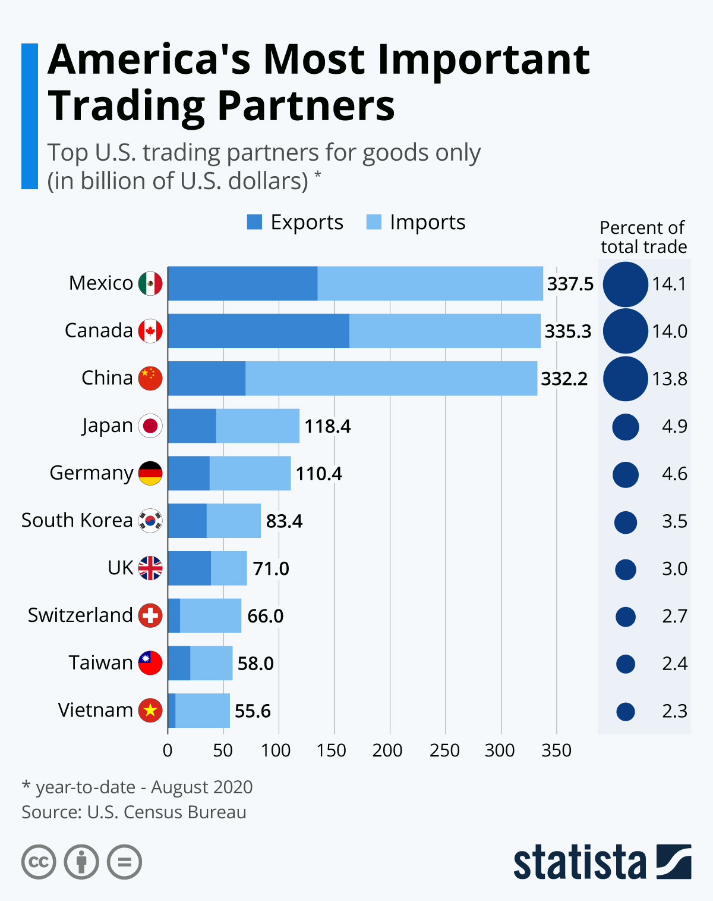
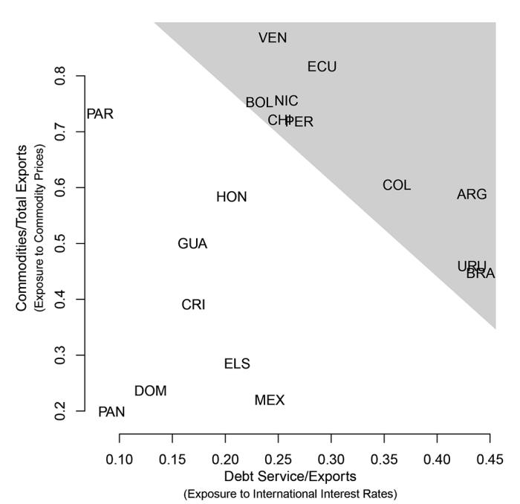
How conditions of the US economy affect presidential success in Mexico?
How conditions of the US economy affect Mexican Economy?
Foreign Trade: represented 83.6% of GDP in 2021 (World Bank)
FDI, Exchange Rate, US-Denominated Debt
Mexican Exports (nonpetroleum): grew rapidly in the 1990s after NAFTA
Not as much? Yet export 4/5 of oil to US*

Slide 5
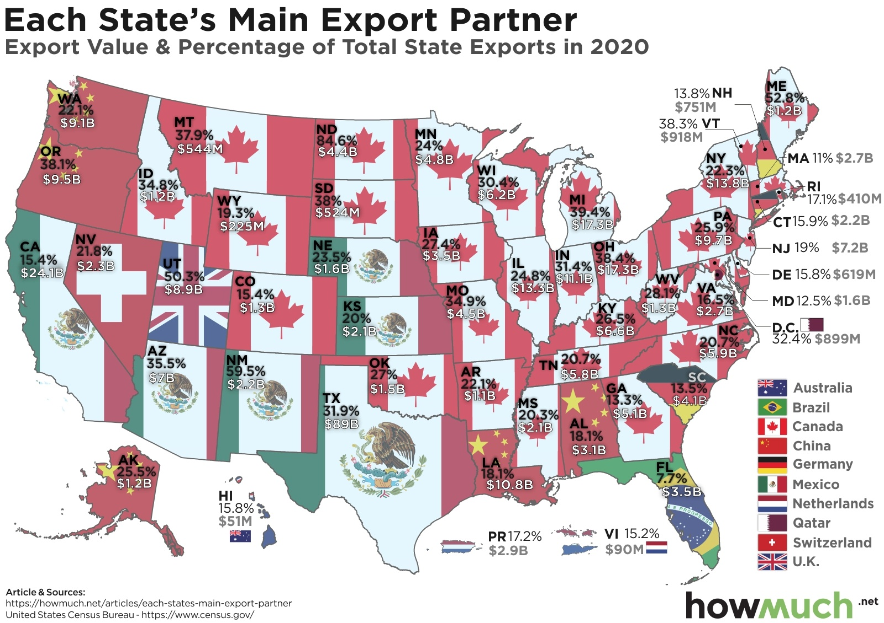
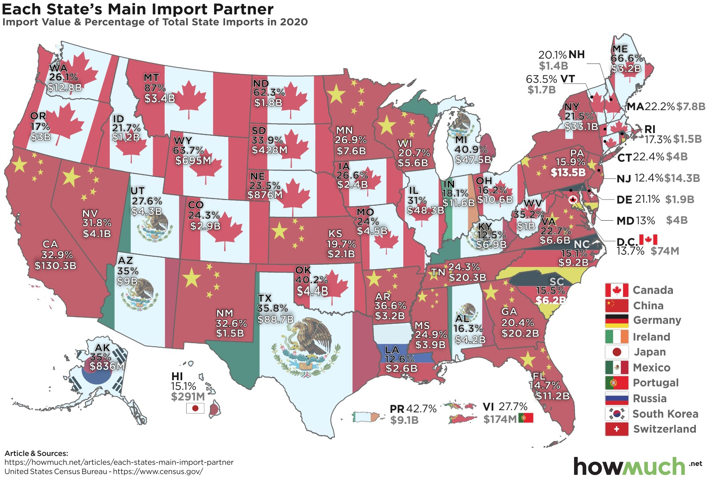
How conditions of the US economy affect presidential success in Mexico?
How conditions of the US economy affect Mexican Economy?
Main Exports: cars (14.3%), automatic data-processing machines (6.7%), vehicle parts (6.2%), petroleum oils (4.8%), and monitors and projectors (3.2%).
Main Imports: accessories for motor vehicles (5.1%), petroleum oils (4.9%), electronic integrated circuits (4.3%), petroleum gas (3.1%), and telephone sets (2.7%)

Slide 6
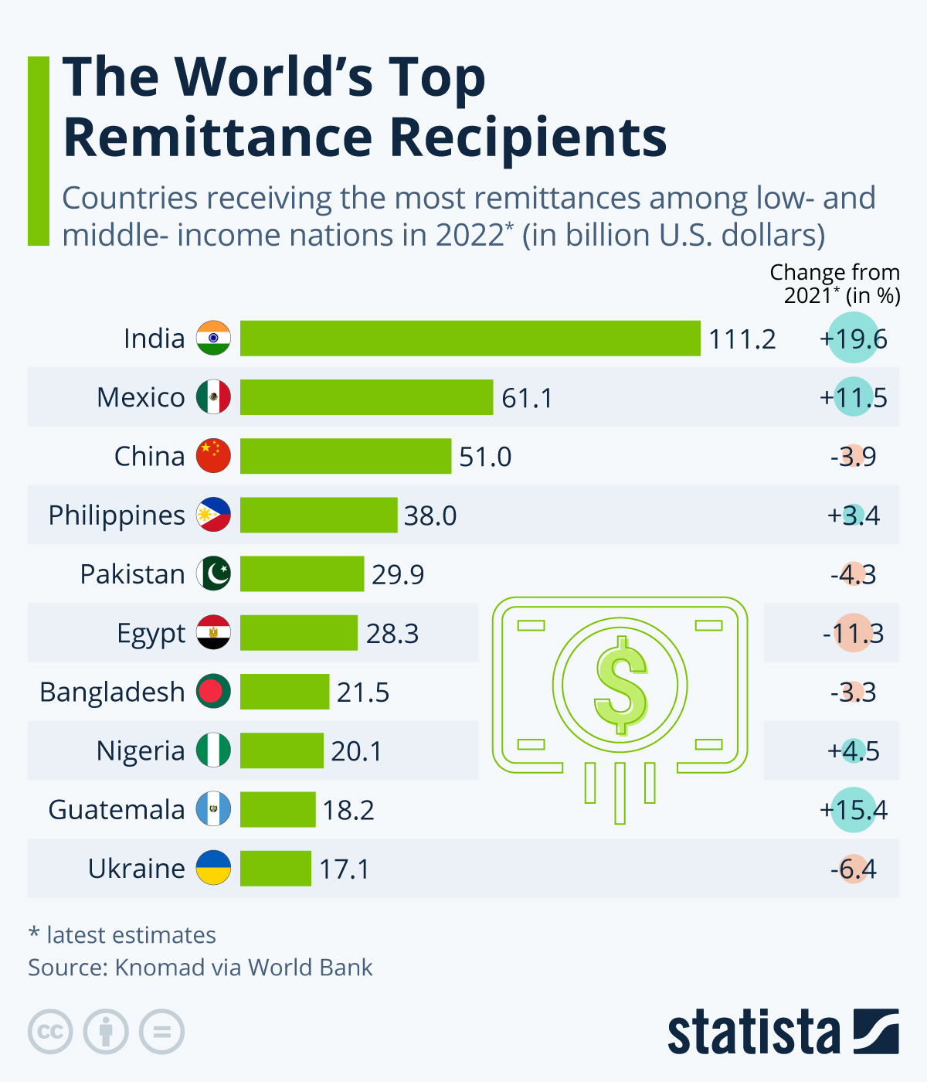
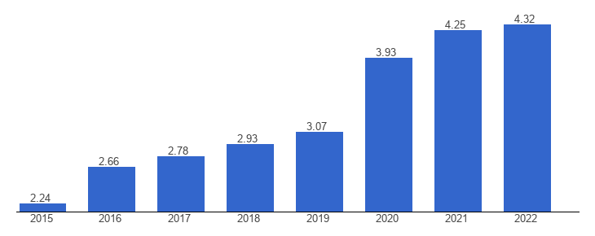
How conditions of the US economy affect presidential success in Mexico?
How conditions of the US economy affect Mexican Economy?
Remmitances: 2 - 4.32% of GDP. But what are the sources of employment?
Labor Markets: Construction - Real Estate (19.5%), Hospitality and Leisure (13.8%)
Transition, in 2000 they worked mainly in the Commerce (23.6%) and Manufacturing (22.5%) sectors
Mexico: Remittances, percent of GDP - Recent values

